Slide 1


NEST JS
SESSION BY
ABHISHEK PATEL AND ANIKET RAMTEKE

Slide 2

Overview
01 | NEST JS
02 | NEST JS VS EXPRESS
03 | NEST JS COMMANDS
04 | NEST JS API FLOW
05 | DECORATORS | PIPES | GUARDS
06 | MIDDLEWARE | DTO | CONFIG SERVICE
07 | EXCEPTION FILTERS | LOGGERS | INTERCEPTORS
08 | Module Registration: Sync vs Async
09 | FACTORY METHOD ASYNC VS SYNC IN PROVIDERS

Slide 3
NEST JS ?
NestJS is a powerful Node.js framework built with TypeScript
Comes with Nest CLI for fast scaffolding and development
Uses Dependency Injection for loose coupling
Based on a modular architecture aligned with SOLID principles
Designed for building maintainable, scalable, and testable backends

Slide 4

NEST JS VS EXPRESS
Feature
Nest Js
Express
Framework Type
Full-featured framework
Minimalist web framework
Modular Architecture
Built-in module system
(like Angular)
Manual code organization
Dependency Injection (DI)
Out of the box, using Reflect Metadata
Not built-in
CLI Tooling
Powerful CLI for scaffolding, testing, building
Limited
Use Case
Enterprise apps, microservices, GraphQL, etc.
Lightweight apps

Slide 5

NEST JS COMMANDS
Nest Cli Installation
Nest Cli Basic Commands
npm i -g @nestjs/cli
Schematic
Command
module
nest g module users
Create Nest Js Project
controller
nest g controller users
nest new <project-name>
service
nest g service users
provider
nest g provider logger
guard
nest g guard auth
pipe
nest g pipe validation
resource
nest g resource user

Slide 6
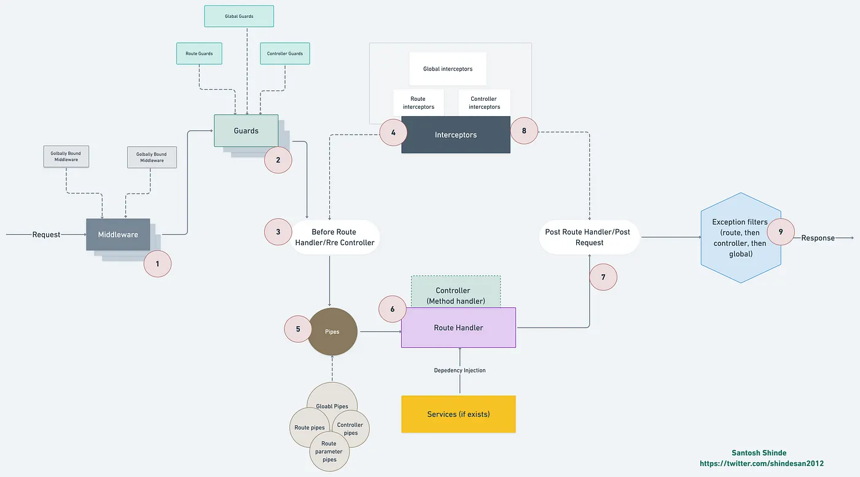

NEST JS API FLOW

Slide 7


MIDDLWARE | DECORATORS | GUARDS
Middleware
Decorators
Guards
In NestJS, Middleware is a function (or class) that gets executed before the route handler. It's often used for tasks that apply to every request.
Decorators are special functions that add extra behavior to classes, methods, or variables.
They start with @ and are used a lot in NestJS
In NestJS, a Guard is a class that determines whether a request can proceed to a route handler.
It acts like a middleware with access control logic, often used for authentication or authorization.

Slide 8
PIPES | DTO | CONFIG SERVICE
Pipes
Dto
Config Service
In NestJS, Pipes are used for transforming and validating incoming data before it reaches the route handler.
They allow you to ensure the incoming data is clean, expected, and in the correct format.
In NestJS, a DTO
(Data Transfer Object) is a TypeScript class used to define the shape and structure of data sent over the network especially for incoming requests and sometimes for outgoing responses.
In NestJS, the ConfigService is part of the @nestjs/config package and is used to manage application environment variables and configuration values in a clean, type-safe, and scalable way.

Slide 9

INTERCEPTORS | LOGGER | EXCEPTION FILTERS
Interceptors
Logger
Exception Filters
In NestJS, Interceptors are powerful tools that allow you to intercept and modify incoming requests or outgoing responses
In NestJS, a Logger is a built-in utility to handle logging in a structured, centralized, and configurable way
In NestJS, Exception Filters are a powerful way to handle errors and exceptions in a centralized, reusable, and consistent manner.

Slide 10
Module Registration: Sync vs Async (Global & Feature)
In NestJS, modules can be registered synchronously or asynchronously using forRoot, forRootAsync, register, and registerAsync.This allows dynamic configuration with or without dependency injection.
Registration Type
Sync Method
Async Method
Scope
UseCase
Global Module
forRoot()
forRootAsync()
Application-wide
Databases (Sequelize, TypeORM), Config
Feature Module
register()
registerAsync()
Feature-specific
JWT, Mailer, Cache, Schedule

Slide 11
FACTORY METHOD: ASYNC VS SYNC
Factory Methods
In NestJS, a factory method is a way to dynamically create and configure providers or module using the useFactory pattern. It's commonly used when the instance you want to inject in the method
Feature
Synchronous Factory
Asynchronous Factory
Usage
Simple values, no await or promises
When you need to await for setup (e.g. DB)
Return Type
Plain value or class
Promise<T>

Slide 12


THANK YOU

